Slide 1
Chapter 4
Trees Binary Search Trees
Objectives
Upon completion you will be able to:
Create and implement binary search trees
Understand the operation of the binary search tree ADT
Write application programs using the binary search tree ADT
Design and implement a list using a BST
AVL tree
B tree
Data Structures: A Pseudocode Approach with C, Second Edition

Slide 2

Nature View of a Tree
leaves
branches
root

Slide 3

Computer Scientist’s View
root
leaves
branches
nodes

Slide 4
First Some Definitions
  A tree has a set of nodes and directed edges that connect them
    a directed edge connects a parent to its children
  Tree properties
    one node is distinguished as the root
    every node (except the root) is connected by an edge from exactly one other node
    A unique path traverses from the root to each node

Slide 5
General Trees
  Trees store data in a hierarchical manner
    Root node is A
    A's children are B, C, and D
    E, F, and D are leaves
    Length of path from A to E is 2 edges
A
Trees have layers of nodes,
where some are higher,
others are lower.
B
C
D
E
F

Slide 6
Some tree terminology
    Node An element in the tree references data and other nodes
    Root The node at the top It is upside down!
    Parent The node directly above another node (except root)
    Child The node(s) below a given node
    Size The number of descendants plus one for the node itself
    Leaves Nodes with no children
    Levels The root A is at level 0, E and F are at level 2

Slide 7
Cont..
Root: node without parent (A)
Siblings: nodes share the same parent
Internal node: node with at least one child (A, B, C, F)
External node (leaf ): node without children (E, I, J, K, G, H, D)
Ancestors of a node: parent, grandparent, grand-grandparent, etc.
Descendant of a node: child, grandchild, grand-grandchild, etc.
Depth of a node: number of ancestors
Height of a tree: maximum depth of any node (3)
Degree of a node: the number of its children
Degree of a tree: the maximum number of its node.
Subtree: tree consisting of a node and its descendants
A
subtree
B
C
D
E
F
G
H
I
J
K

Slide 8
A Binary Search Tree is a binary tree with the following properties:
All items in the left subtree are less than the root.
All items in the right subtree are greater or equal to the root.
Each subtree is itself a binary search tree.
Data Structures: A Pseudocode Approach with C, Second Edition

Slide 9
Basic Property
In a binary search tree,
the left subtree contains key values less than the root
the right subtree contains key values greater than or equal to the root.
Data Structures: A Pseudocode Approach with C, Second Edition

Slide 10
7-1 Basic Concepts
Binary search trees provide an excellent structure for searching a list and at the same time for inserting and deleting data into the list.
Data Structures: A Pseudocode Approach with C, Second Edition

Slide 11
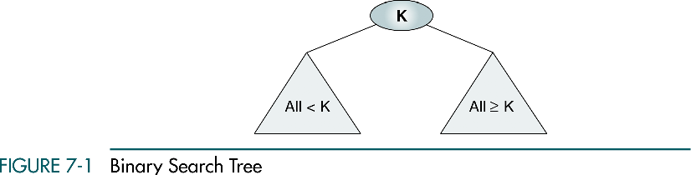
Data Structures: A Pseudocode Approach with C, Second Edition

Slide 12
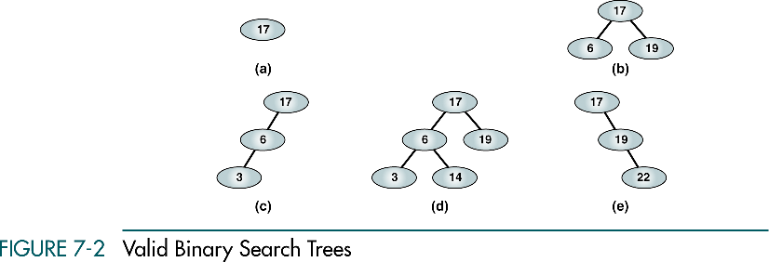
(a), (b) - complete and balanced trees;
(d) – nearly complete and balanced tree;
(c), (e) – neither complete nor balanced trees
Data Structures: A Pseudocode Approach with C, Second Edition

Slide 13
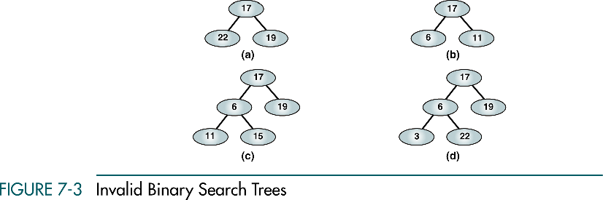
Data Structures: A Pseudocode Approach with C, Second Edition

Slide 14
7-2 BST Operations
We discuss four basic BST operations: traversal, search, insert, and delete; and develop algorithms for searches, insertion, and deletion.
Traversals
Searches
Insertion
Deletion
Data Structures: A Pseudocode Approach with C, Second Edition

Slide 15
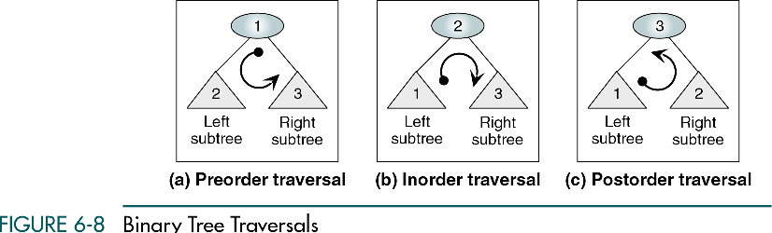
Data Structures: A Pseudocode Approach with C, Second Edition

Slide 16
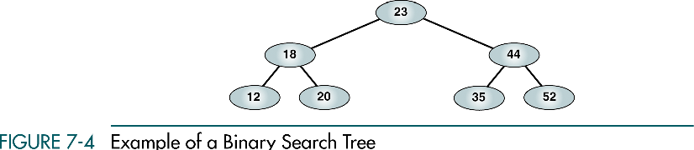
Data Structures: A Pseudocode Approach with C, Second Edition

Slide 17
Preorder Traversal
23 18 12 20 44 35 52
Data Structures: A Pseudocode Approach with C, Second Edition

Slide 18
Postorder Traversal
12 20 18 35 52 44 23
Data Structures: A Pseudocode Approach with C, Second Edition

Slide 19
Inorder Traversal
12 18 20 23 35 44 52
Inorder traversal of a binary search tree produces a sequenced list
Data Structures: A Pseudocode Approach with C, Second Edition

Slide 20
Right-Node-Left Traversal
52 44 35 23 20 18 12
Right-node-left traversal of a binary search tree produces a descending sequence
Data Structures: A Pseudocode Approach with C, Second Edition

Slide 21
Three BST search algorithms:
Find the smallest node
Find the largest node
Find a requested node
Data Structures: A Pseudocode Approach with C, Second Edition

Slide 22
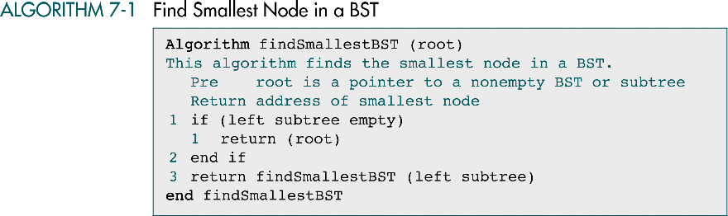
Data Structures: A Pseudocode Approach with C, Second Edition

Slide 23
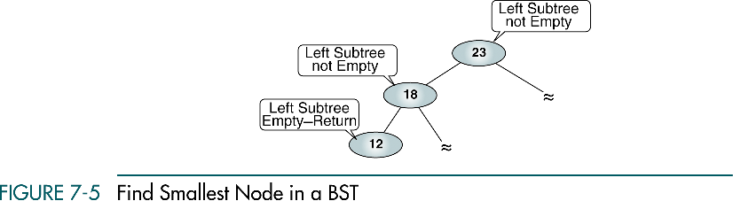
Data Structures: A Pseudocode Approach with C, Second Edition

Slide 24
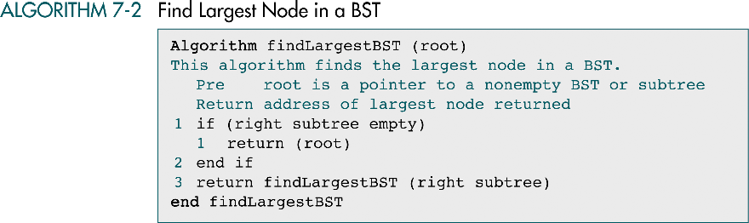
Data Structures: A Pseudocode Approach with C, Second Edition

Slide 25
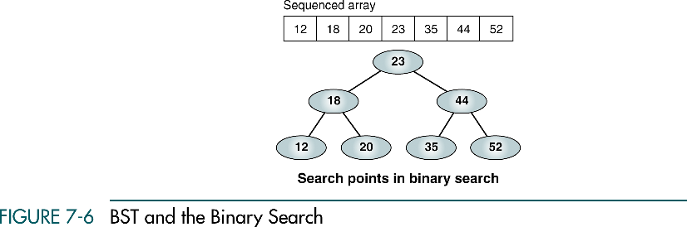
Data Structures: A Pseudocode Approach with C, Second Edition

Slide 26
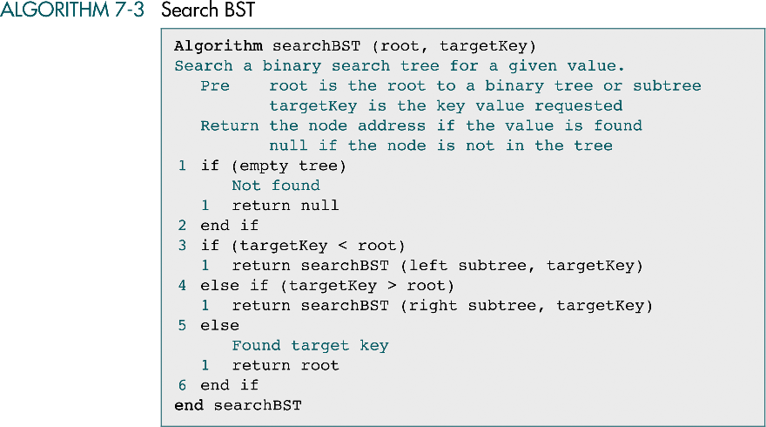
Data Structures: A Pseudocode Approach with C, Second Edition

Slide 27
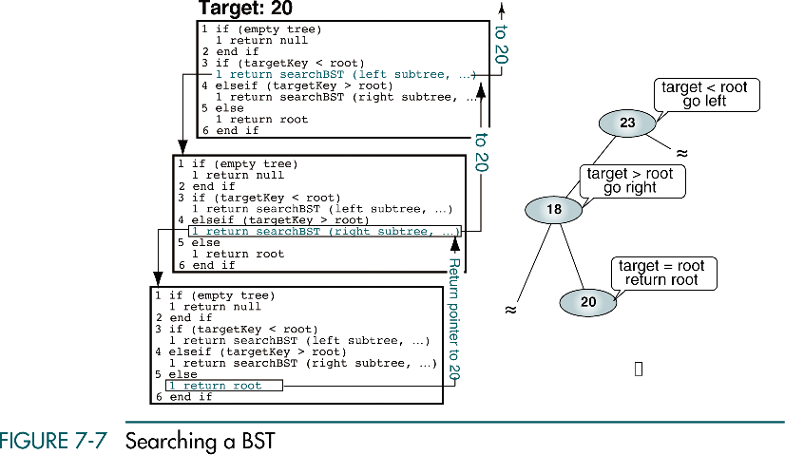
Data Structures: A Pseudocode Approach with C, Second Edition

Slide 28
BST Insertion
To insert data all we need to do is follow the branches to an empty subtree and then insert the new node.
In other words, all inserts take place at a leaf or at a leaflike node – a node that has only one null subtree.
Data Structures: A Pseudocode Approach with C, Second Edition

Slide 29
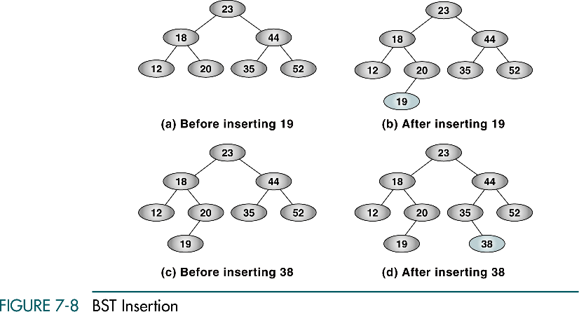
Data Structures: A Pseudocode Approach with C, Second Edition

Slide 30
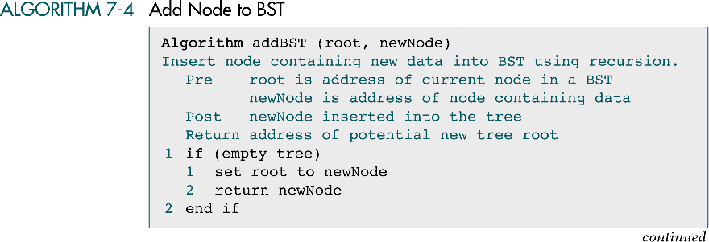
Data Structures: A Pseudocode Approach with C, Second Edition

Slide 31
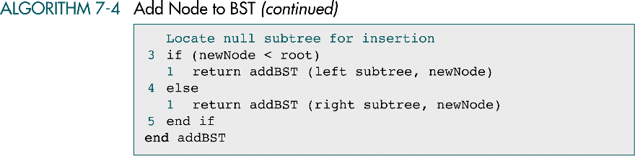
Data Structures: A Pseudocode Approach with C, Second Edition

Slide 32
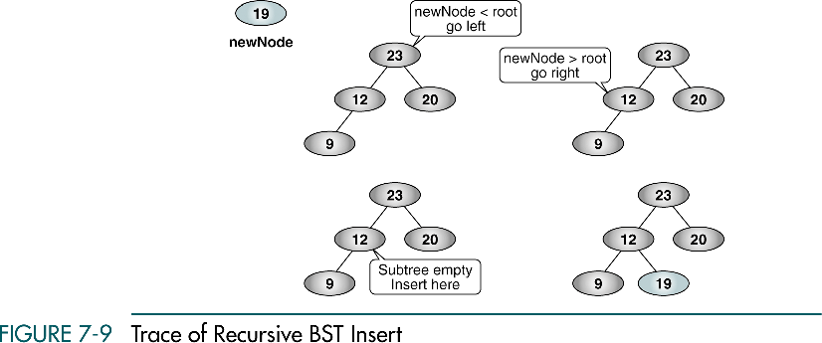
30
30
30
30
Data Structures: A Pseudocode Approach with C, Second Edition

Slide 33
Deletion
There are the following possible cases when we delete a node:
The node to be deleted has no children. In this case, all we need to do is delete the node.
The node to be deleted has only a right subtree. We delete the node and attach the right subtree to the deleted node’s parent.
The node to be deleted has only a left subtree. We delete the node and attach the left subtree to the deleted node’s parent.
The node to be deleted has two subtrees. It is possible to delete a node from the middle of a tree, but the result tends to create very unbalanced trees.
Data Structures: A Pseudocode Approach with C, Second Edition

Slide 34
Deletion from the middle of a tree
Rather than simply delete the node, we try to maintain the existing structure as much as possible by finding data to take the place of the deleted data. This can be done in one of two ways.
Data Structures: A Pseudocode Approach with C, Second Edition

Slide 35
Deletion from the middle of a tree
We can find the largest node in the deleted node’s left subtree and move its data to replace the deleted node’s data.
We can find the smallest node on the deleted node’s right subtree and move its data to replace the deleted node’s data.
Either of these moves preserves the integrity of the binary search tree.
Data Structures: A Pseudocode Approach with C, Second Edition

Slide 36
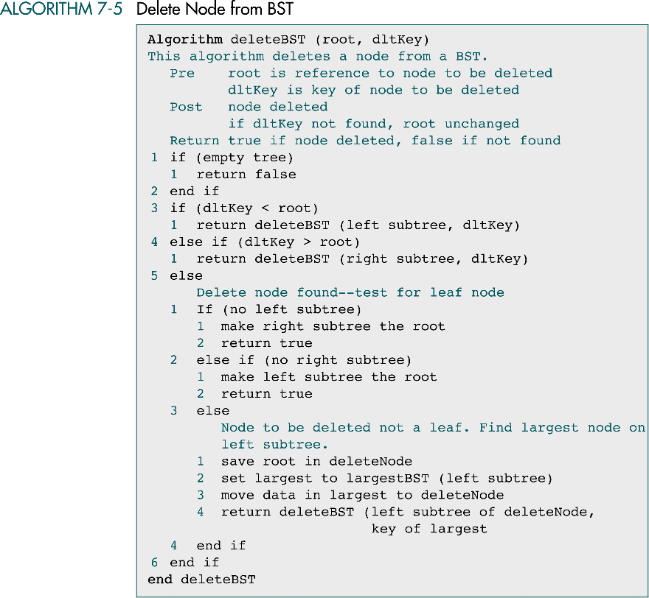
Data Structures: A Pseudocode Approach with C, Second Edition

Slide 37
(continued)
Data Structures: A Pseudocode Approach with C, Second Edition

Slide 38
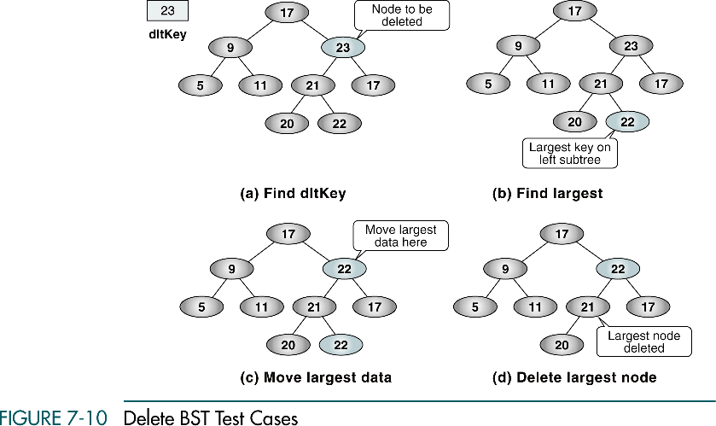
27
27
27
27
Data Structures: A Pseudocode Approach with C, Second Edition

Slide 39
7-3 Binary Search Tree ADT
We begin this section with a discussion of the BST data structure and write the header file for the ADT. We then develop 14 programs that we include in the ADT.
Data Structure
Algorithms
Data Structures: A Pseudocode Approach with C, Second Edition

Slide 40
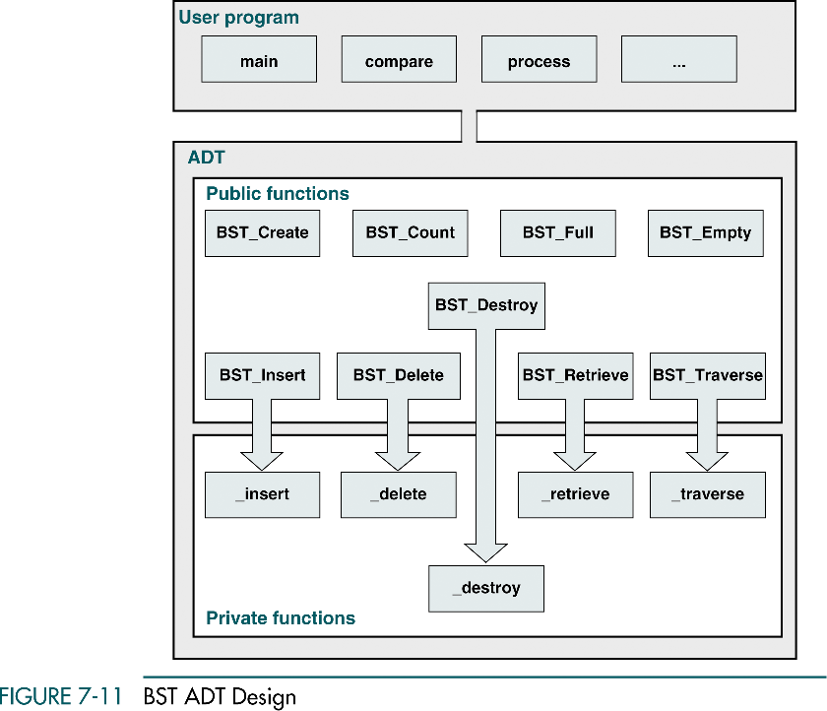
Data Structures: A Pseudocode Approach with C, Second Edition

Slide 41
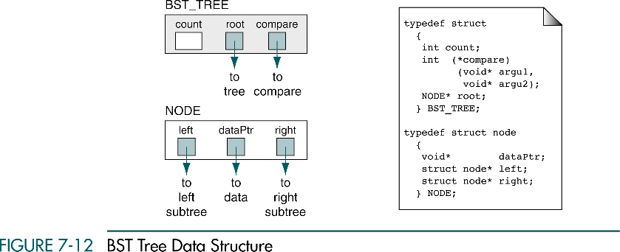
Data Structures: A Pseudocode Approach with C, Second Edition

